Slide 1
Welcome to:
CSCI3150/ESTR3102
Intro. to Operating Systems

Slide 2
Lecturer and Tutors
Lecturer: Dr. Zili SHAO
Office: SHB 909
Telephone No.: 39434258
Email: zilishao@cuhk.edu.hk
Homepage: http://www.cse.cuhk.edu.hk/~shao/
Consultation time: Upon request
Tutors Email
Zhiqi WANG zqwang@cse.cuhk.edu.hk
Zizhan Chen chenzz@cse.cuhk.edu.hk
Kai ZHANG kaizhang@link.cuhk.edu.hk
Jin XUE jinxue@cse.cuhk.edu.hk
Kecheng HUANG kchuang21@cse.cuhk.edu.hk

Slide 3

About me
Research
  Big data systems
  Storage systems
  Embedded systems and software
  http://www.cse.cuhk.edu.hk/~shao/
I love and enjoy computer system research
  Join my group if you have interests

Slide 4
About the course
Course website
https://blackboard.cuhk.edu.hk
Textbook: Operating Systems: Three Easy Pieces
  A free online OS book
  http://pages.cs.wisc.edu/~remzi/OSTEP/
  Authors: Remzi H. Arpaci-Dusseau and Andrea C. Arpaci-Dusseau
Reference book: Operating System Concepts, 2018
  http://codex.cs.yale.edu/avi/os-book/OS10/index.html
  Authors: Avi Silberschatz, Peter Baer Galvin, and Greg Gagne

Slide 5
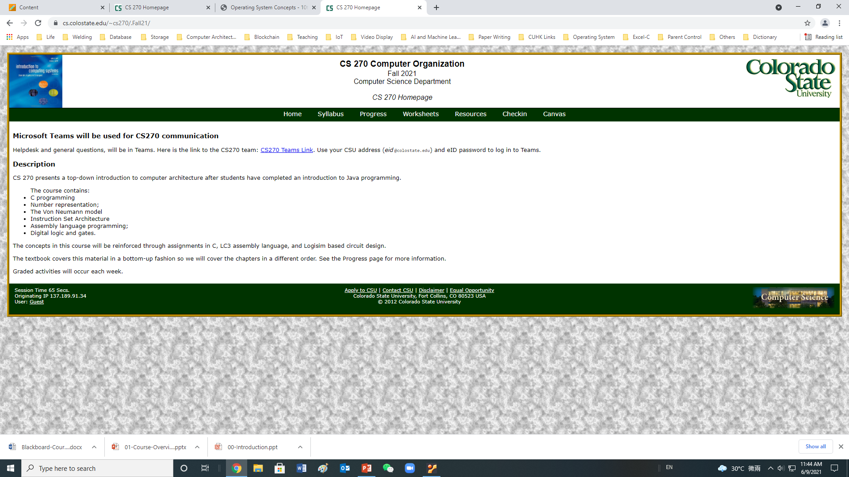
More References
Introduction to Computing Systems: From Bits and Gates to C and Beyond, Authors: Yale N. Patt and Sanjay J. Patel
A Computer Organization Course from Colorado State University
Beginning Linux Programming, 4th Edition, 2007, Authors: Neil Matthew and Richard Stones

Slide 6
Topics Covered
Focus
  User-level programming (System calls)
  File system
  Process management
  Memory management
  Concurrency
Others (briefly introduced with the above)
  Protection and security
  Design/implementation methodology
  Performance evaluation

Slide 7

Background required
Basic knowledge
  Data structures
  Programming in C
Linux System
  Log into a Linux system;
  Create files using one editor;
  Basic commands for files/directories;
  Compile C programs
Linux Basic: https://naivewong.github.io/
Tutorial: http://pages.cs.wisc.edu/~remzi/OSTEP/lab-tutorial.pdf

Slide 8
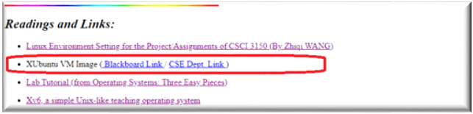
Linux Environment
The first step to succeed for this course – have a good Linux environment controlled by yourself
You are required to follow the tutorial below to create a Linux environment running on VM based on VirtualBox at your own computer (Windows/OS X)
https://naivewong.github.io/
The VM image can be downloaded from the link:
A Blackboard link from the course website:
https://www.cse.cuhk.edu.hk/~shao/zili_files/csci3150/3150_XUbuntu.ova
A lab in Week 2 will be provided to help you on this (Labs will start from Week 2)

Slide 9
The Course Organization (Bottom-up)
Race Conditions, Lock/Semaphore
Concurrency
Thread
Memory Management
HW#4
Virtualization
Process and CPU Scheduling
HW#3
IO Devices and Storage
HW#2
&
Project
Persistence
File System
System Calls (User-level Programming)
HW#1

Slide 10
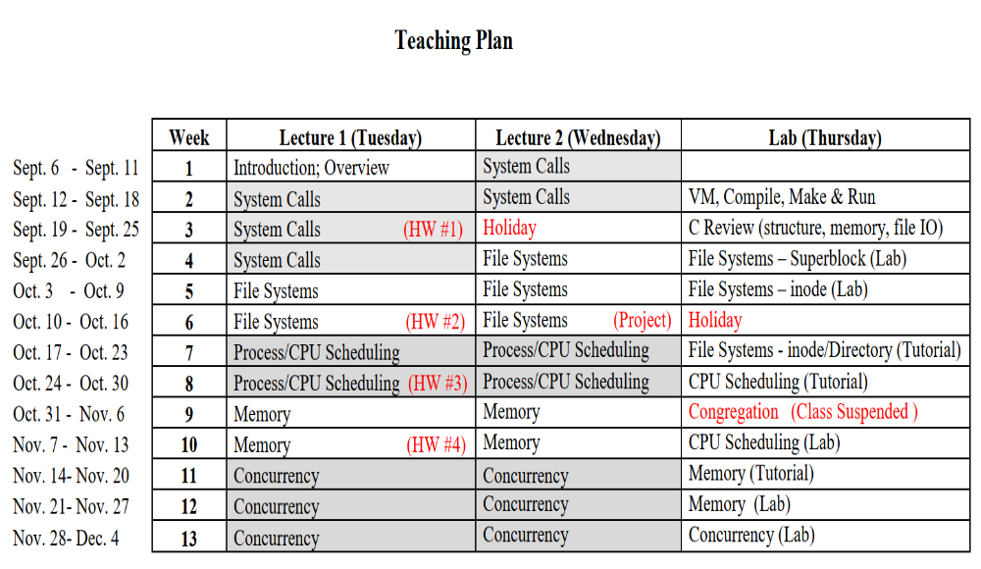
Teaching Plan

Slide 11
Assessment
Continuous assessment: 60%
  Labs (around 4; programming related; simple) 5%
  Four Assignments 40%
    Assignment 1 (10%) - Simple Shell (Program, Group)
    Assignment 2 (10%) - File system (Paper)
    Assignment 3 (10%) - MLFQ Scheduling (Paper)
    Assignment 4 (10%) - Memory management (Paper)
  Project (File System, Program) 15%
  Bonus 10%
    Bonus Programming Assignment 1 (5%) - MLFQ Scheduling
    Bonus Programming Assignment 2 (5%) - Memory management
  Late submission policy: 20% deduction per day (1 minute or 23 hours no difference)
  We only grade based on what you submit in the Blackboard.
Final Exam: 40%

Slide 12
Plagiarism & Absence
All assignments (except Assignment one) need to be done individually
  Discussion is encouraged but you need to implement them yourself
  It is your responsibility to protect your code (e.g. private github)
Plagiarism
  Plagiarism check will be conducted extensively for fairness and good culture
  Processing
    Rule 1: First incident, the score of that whole assignment will be 0 for all involved persons (i.e. both solution providers and cheaters)
    Rule 2: Repeat incident, follow Rule 1, and the case (i.e. all students involved) will be reported to the department
Absence
  Class attendance is extremely important
    One class focus: Help on the assignments
  For the final exam, the makeup one will be much much much more difficult

